Slide 1
Using Non-dominated Sorting Genetic Algorithm-II for Charging Station Deployment in Wireless Rechargeable Sensor Networks
在WRSN環境下使用NSGA-II演算法佈置無線充電站
口試日期: 7/01
報告者: 胡翔崳
指導教授: 高勝助

Slide 2
Outline
Introduction
Problem Definition
Method
Movable-Charger-based Algorithm
Non-dominated Sorting Genetic Algorithm-II
Simulation
Conclusions

Slide 3
Introduction WSN
Wireless Sensor Networks (WSN)
Wireless sensor nodes, relay nodes
Advantages
Lower cost
Scalability
Reliability
Flexibility
Ease of deployment
Sensor nodes is limited by battery capacity

Slide 4
Introduction WRSN
Wireless Rechargeable Sensor Network (WRSN)
Wireless energy transfer
Rechargeable lithium batteries
Charging stations, sensor nodes and relay nodes

Slide 5
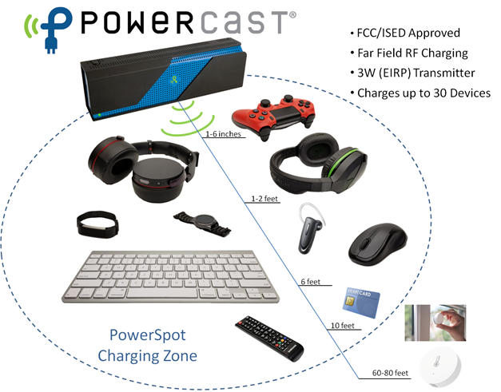
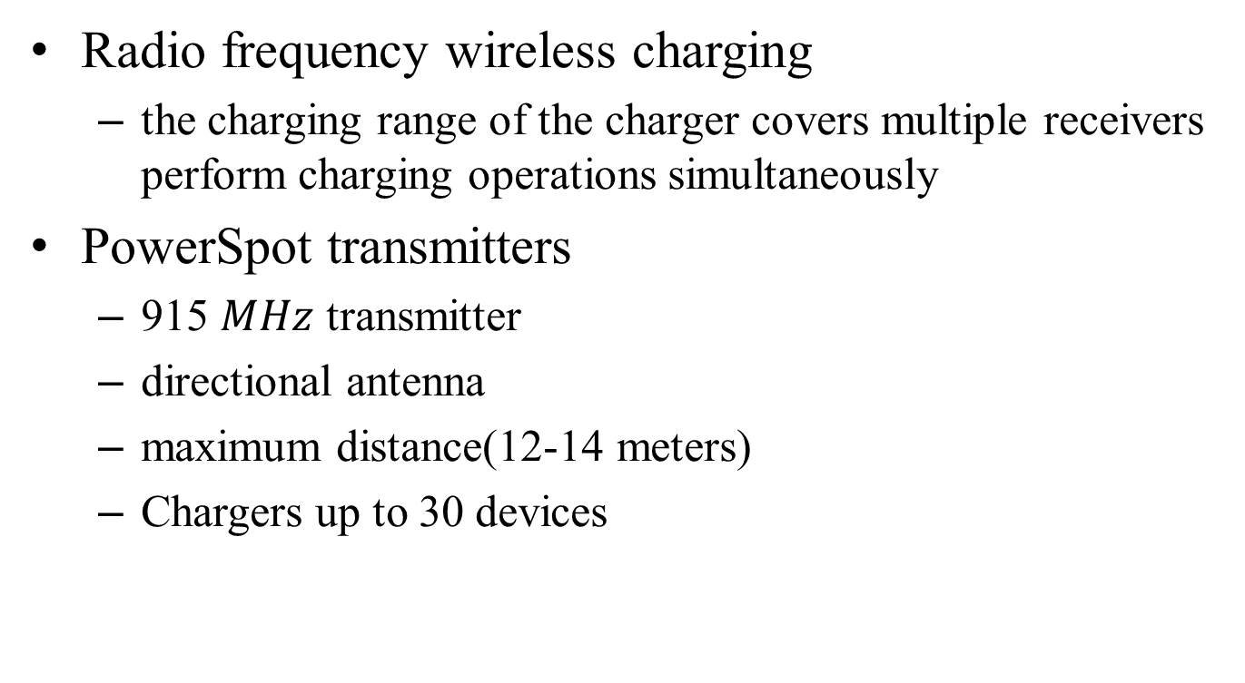
Introduction Wireless Charging
Radio frequency wireless charging
the charging range of the charger covers multiple receivers perform charging operations simultaneously
PowerSpot transmitters
915 $MHz$ transmitter
directional antenna
maximum distance(12-14 meters)
Chargers up to 30 devices
https://www.powercastco.com/products/powerspot/

Slide 6
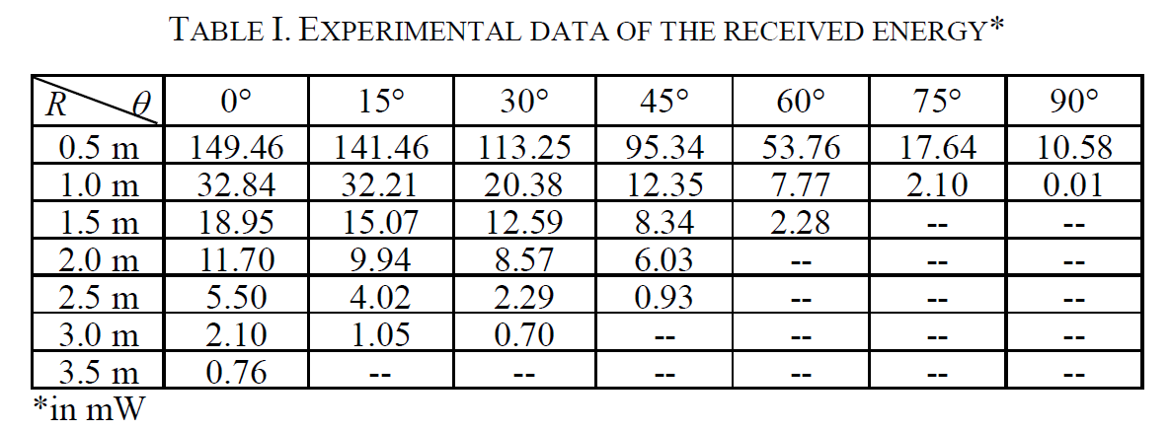
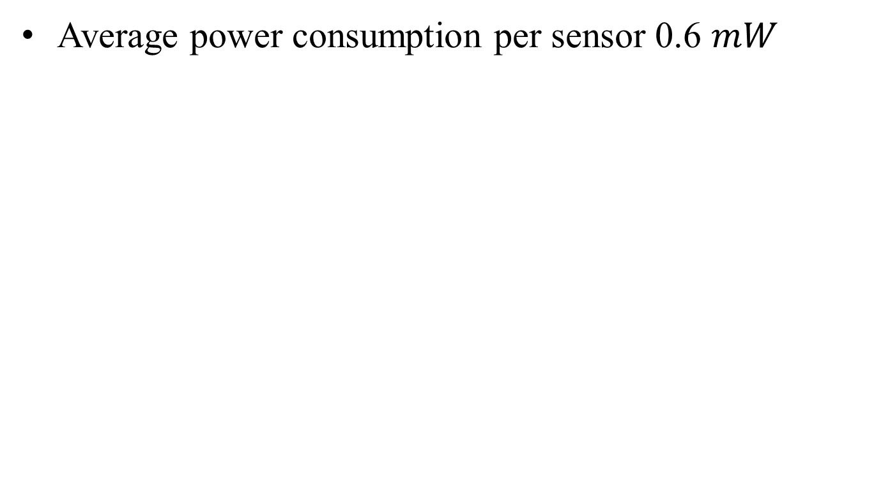
Introduction PowerSpot Transmitters
Average power consumption per sensor 0.6 $mW$
Particle Swarm Optimization for Charger Deployment in Wireless Rechargeable Sensor Networks

Slide 7

Introduction Problem
Wireless charging stations are costly and have limited charging distances
How to deploy minimize charging stations to cover all sensor nodes is an important and challenging problem
Notes:
因為無線充點站有者充電距離的限制，並且價格也不便宜
所以要如何用最少的充電站並且能夠滿足每個感測器的能量需求是本篇研究所要解決的重點

Slide 8
Introduction Relate Work
Movable-charger-based planning scheme in wireless rechargeable sensor networks
[ Jian et al. ]
An Efficient Charger Planning Mechanism of WRSN using Simulated Annealing Algorithm
[ Chien et al. ]
Enhanced SA-based Charging Algorithm for WRSN
[ Chien et al. ]

Slide 9
Introduction Purpose
Previous methods do reduce the number of charging stations
Not consider the charging efficiency of each sensor node
When the distance between sensor node and charging station decreases, the charging efficiency will be increased
Goals
Reduce charging stations
Increase charging efficiency

Slide 10

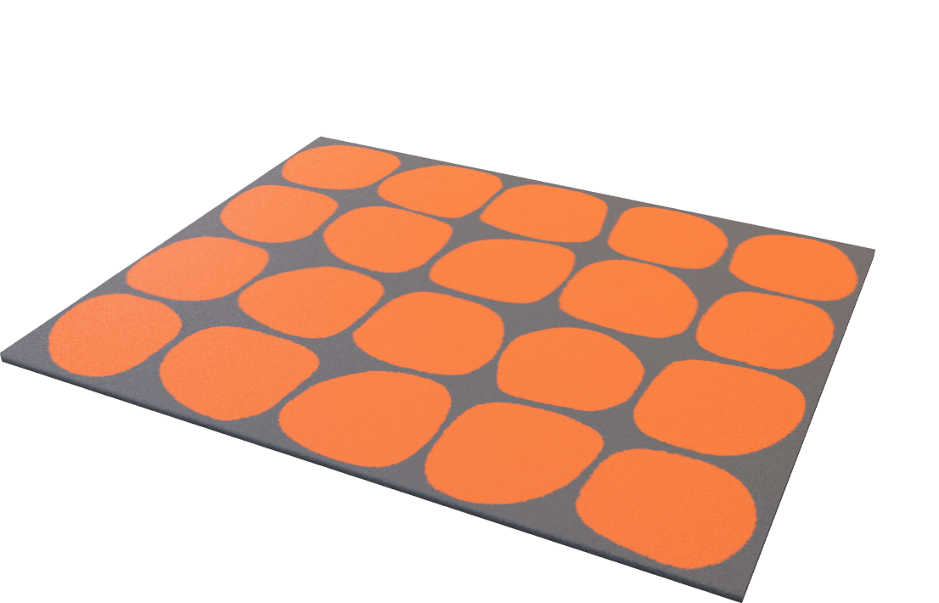
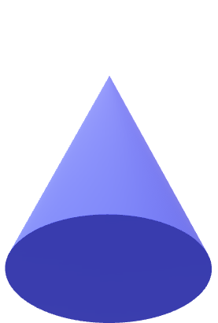
Problem Definition WRSN Network Model
charger
sensor
15 m
20 m

Slide 11
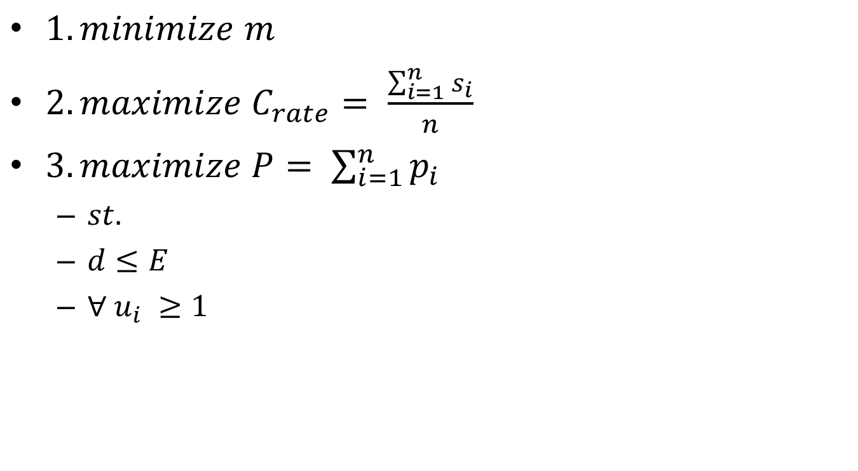
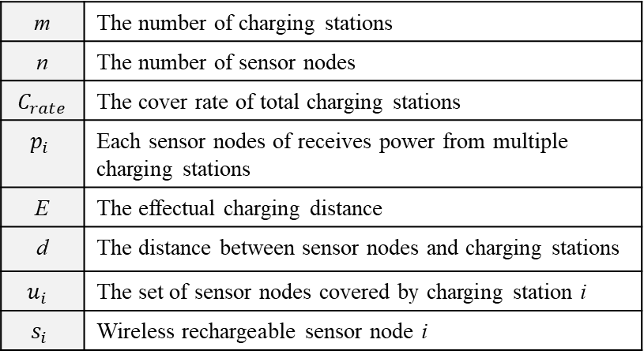
Problem Definition Mathematical Model
$1.minimize m$
$2.maximize C_{rate}= \frac{\sum_{i=1}^{n}{s_{i}}}{n}$
$3.maximize P= \sum_{i=1}^{n}{p_{i}}$
$st.$
$d≤E$
$∀ u_{i} ≥1$
m | The number of charging stations
n | The number of sensor nodes
$C_{rate}$ | The cover rate of total charging stations
$$p_{i}$$ | Each sensor nodes of receives power from multiple charging stations
E | The effectual charging distance
d | The distance between sensor nodes and charging stations
$$u_{i}$$ | The set of sensor nodes covered by charging station i
$$s_{i}$$ | Wireless rechargeable sensor node i

Slide 12
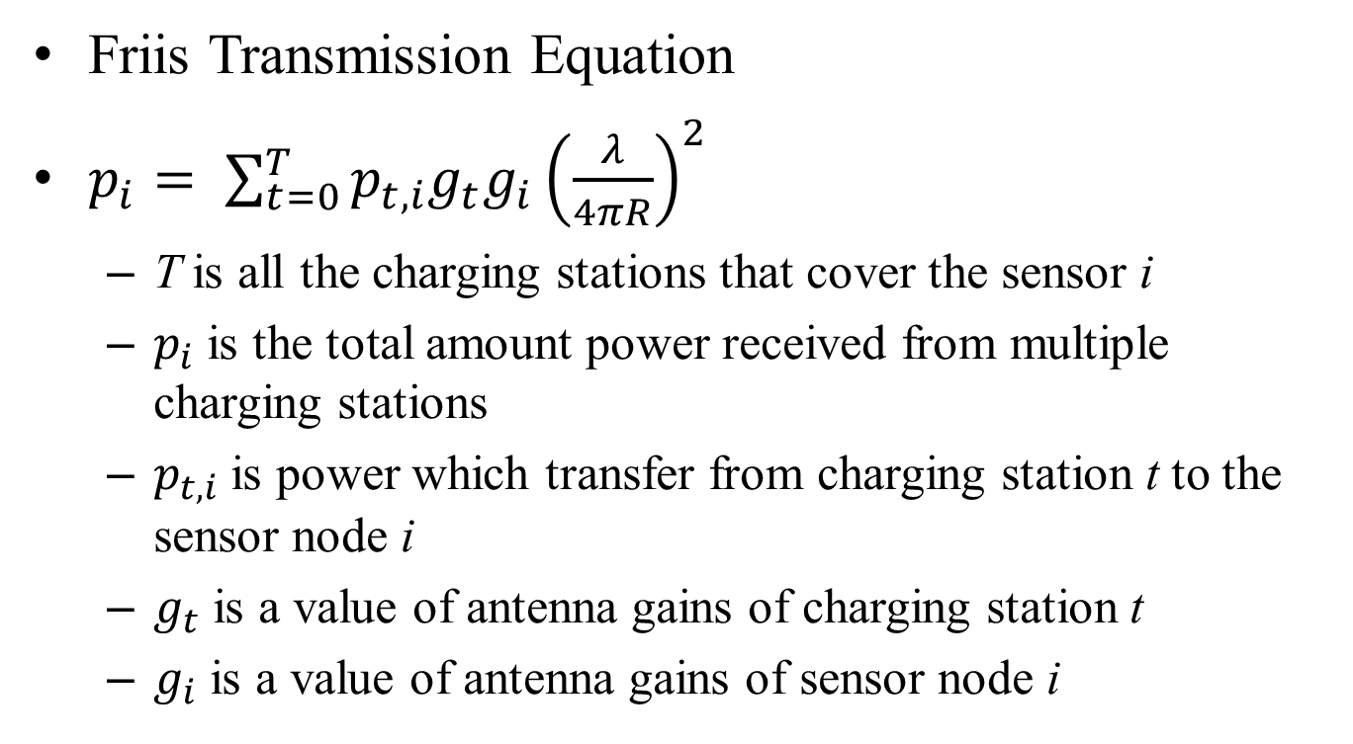
Problem Definition Wireless Charging Model
Friis Transmission Equation
$p_{i}= \sum_{t=0}^{T}{p_{t,i}g_{t}g_{i}{\left(\frac{λ}{4πR}\right)}^{2}}$
T is all the charging stations that cover the sensor i
$p_{i}$ is the total amount power received from multiple charging stations
$p_{t,i}$is power which transfer from charging station t to the sensor node i
$g_{t}$ is a value of antenna gains of charging station t
$g_{i}$ is a value of antenna gains of sensor node i

Slide 13
Method Two Step
Step1 : Movable-Charger-based Algorithm
Find candidate locations
Step2 : Non-dominated Sorting Genetic Algorithm-II
Find the best location

Slide 14
Movable-Charger-based Algorithm
3m
30

Slide 15
Movable-Charger-based Algorithm
The centroid of triangle within three circles and two circles
CR

Slide 16
NSGA-II
NSGA-II (Non-dominated Sorting Genetic Algorithm-II) is a Multiple Objective Optimization (MOO) algorithm
Initialize
Crossover
Mutation
Selection (Non-dominated Sorting, Crowding Distance)

Slide 17

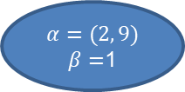
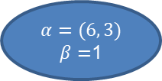
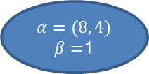
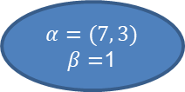
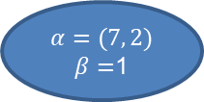
NSGA-II Encoding Chromosome
5 candidate locations
1 deployed
0 not deployed
$$α=(2, 9)$$
$β=$1
$$α=(6, 3)$$
$β=$1
$$α=(7, 2)$$
$β=$1
$$α=(7, 3)$$
$β=$1
$$α=(8, 4)$$
$β=$1

Slide 18
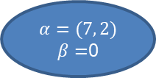
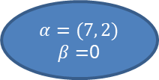
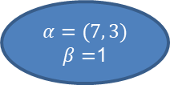
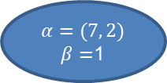
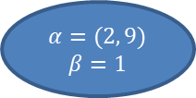
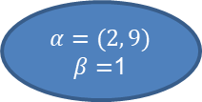
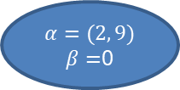
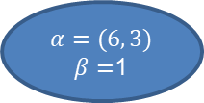
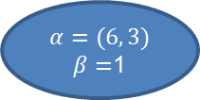
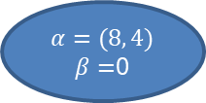
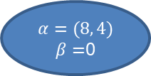

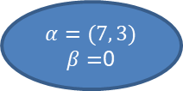
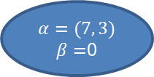
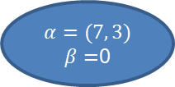
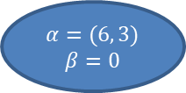
NSGA-II Initialize (Random)
$$α=(2, 9)$$
$β=$0
$$α=(6, 3)$$
$β=$1
$$α=(7, 2)$$
$β=$1
$$α=(7, 3)$$
$β=$0
$$α=(8, 4)$$
$β=$0
$$α=(2, 9)$$
$β=$1
$$α=(6, 3)$$
$β=$1
$$α=(7, 2)$$
$β=$0
$$α=(7, 3)$$
$β=$0
$$α=(8, 4)$$
$β=$1
$$α=(2, 9)$$
$β=$1
$$α=(6, 3)$$
$β=$1
$$α=(7, 2)$$
$β=$0
$$α=(7, 3)$$
$β=$0
$$α=(8, 4)$$
$β=$0
$$α=(2, 9)$$
$$β=1$$
$$α=(6, 3)$$
$$β=0$$
$$α=(7, 2)$$
$β=$1
$$α=(7, 3)$$
$β=$1
$$α=(8, 4)$$
$β=$1

Slide 19
NSGA-II Crossover
0
1
0
1
1
0
0
0
1
1
1
0
0
0
1
1
1
0
0
0
1
0
0
1
0
1
1
1

Slide 20
NSGA-II Mutation
0
1
1
0
1
0
1
1
0
1
0
1
1
0
1
1
1
0
1
0
0

Slide 21
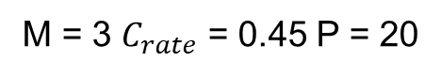
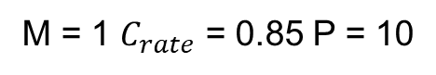
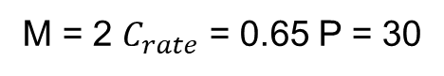
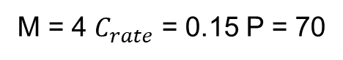
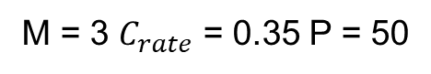
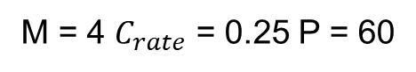
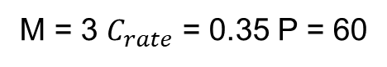
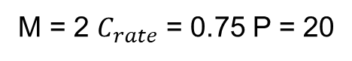
NSGA-II Selection
0
1
1
0
0
M = 2 $C_{rate}$ = 0.75 P = 20
1
1
0
0
1
M = 3 $C_{rate}$ = 0.45 P = 20
1
1
0
0
0
M = 1 $C_{rate}$ = 0.85 P = 10
1
0
1
1
1
M = 4 $C_{rate}$ = 0.25 P = 60
0
1
1
0
1
M = 3 $C_{rate}$ = 0.35 P = 60
1
1
0
1
0
M = 3 $C_{rate}$ = 0.35 P = 50
1
1
0
1
1
M = 4 $C_{rate}$ = 0.15 P = 70
1
0
1
0
0
M = 2 $C_{rate}$ = 0.65 P = 30
Notes:
Selection 排除不必要的解
選擇要進入下一輪的四個解

Slide 22
NSGA-II Nondominated vs. Dominated
dominated
500G/$1800
500G/$2000
nondominated
500G/$1800
640G/$2300

Slide 23
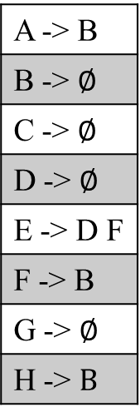
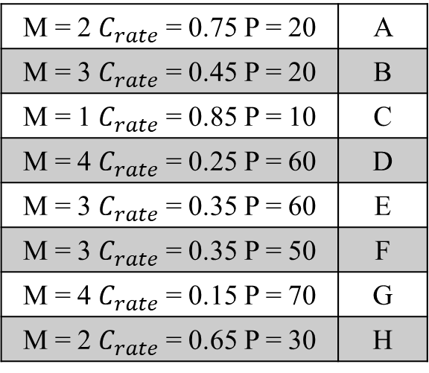
NSGA-II Non-dominated Sorting
M = 2 $C_{rate}$ = 0.75 P = 20 | A
M = 3 $C_{rate}$ = 0.45 P = 20 | B
M = 1 $C_{rate}$ = 0.85 P = 10 | C
M = 4 $C_{rate}$ = 0.25 P = 60 | D
M = 3 $C_{rate}$ = 0.35 P = 60 | E
M = 3 $C_{rate}$ = 0.35 P = 50 | F
M = 4 $C_{rate}$ = 0.15 P = 70 | G
M = 2 $C_{rate}$ = 0.65 P = 30 | H
A -> B
B -> $∅$
C -> $∅$
D -> $∅$
E -> D F
F -> B
G -> $∅$
H -> $B$
Level 1
A C E G H
Level 2
D F
Level 3
B

Slide 24
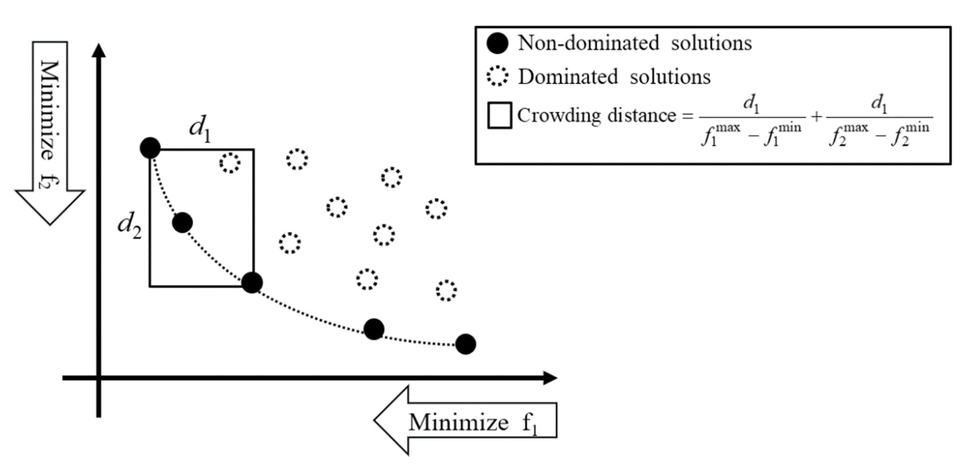
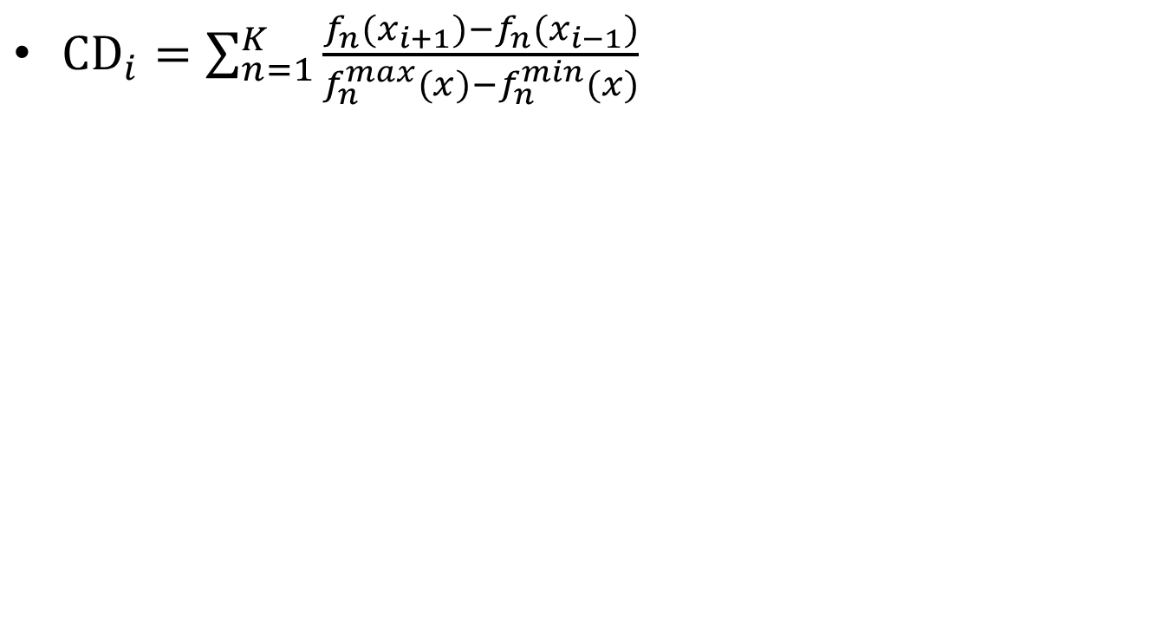
NSGA-II Crowding Distance
${CD}_{i}=\sum_{n=1}^{K}{\frac{f_{n}(x_{i+1})−f_{n}(x_{i−1})}{f_{n}^{max}(x)−f_{n}^{min}(x)}}$
Notes:
密度估計：根據每一目標函式計算該點兩側的兩個點的平均距離，該值作為以最近鄰居作為頂點的長方體周長的估計（作為擁擠係數）

Slide 25
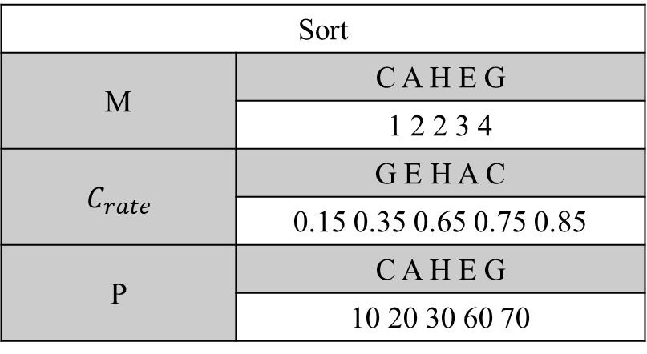
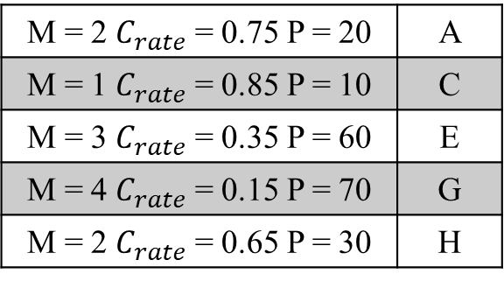
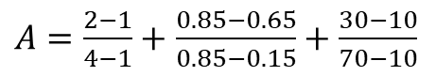
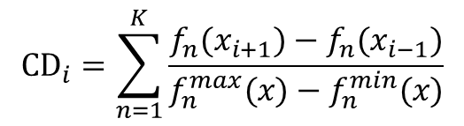
NSGA-II Crowding Distance
M = 2 $C_{rate}$ = 0.75 P = 20 | A
M = 1 $C_{rate}$ = 0.85 P = 10 | C
M = 3 $C_{rate}$ = 0.35 P = 60 | E
M = 4 $C_{rate}$ = 0.15 P = 70 | G
M = 2 $C_{rate}$ = 0.65 P = 30 | H
$${CD}_{i}=\sum_{n=1}^{K}{\frac{f_{n}(x_{i+1})−f_{n}(x_{i−1})}{f_{n}^{max}(x)−f_{n}^{min}(x)}}$$
$A=\frac{2−1}{4−1}+$ $\frac{0.85−0.65}{0.85−0.15}+\frac{30−10}{70−10}$
Sort
M | C A H E G
 | 1 2 2 3 4
$C_{rate}$ | G E H A C
 | 0.15 0.35 0.65 0.75 0.85
P | C A H E G
 | 10 20 30 60 70
A C E G H
C E G H

Slide 26
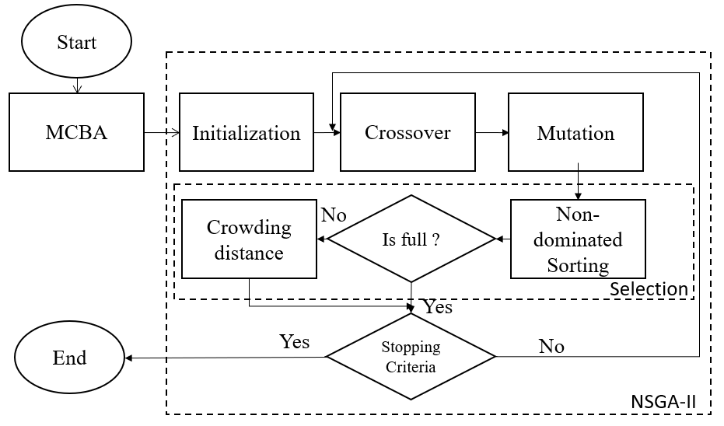
NSGA-II Flowchart

Slide 27
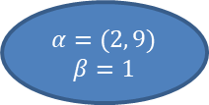
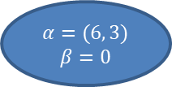
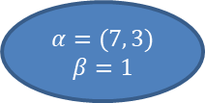
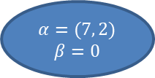
NSGA-II Decoding Chromosome
$$α=(2, 9)$$
$β=1$
$$α=(6, 3)$$
$β=0$
$$α=(7, 2)$$
$$β=0$$
$$α=(7, 3)$$
$$β=1$$
$$α=(8, 4)$$
$β=$0

Slide 28

Simulation Parameter Setting
Parameters | Setting
Size of venue | 15 x 20 x 2.3 $m^{3}$
Number of sensor nodes | 25 ~ 125
Effectual charging distance | 3 $m$
Transmitted Power | 3 $W EIRP$
Receiver Antenna Gain | 6 $dBi$
Frequency | 915 $MHz$
Population | 10
Crossover rate | 1
Mutation rate | 0.8
Iteration | 1000

Slide 29
Simulation Parameter Experiment
Charging station vs. iterations when mutation rate is 0.8

Slide 30
Simulation Parameter Experiment
Charging station vs. iterations when crossover rate is 1

Slide 31
Simulation Charging Station vs. Sensor Nodes

Slide 32

Simulation Sensor Node Average Received Power

Slide 33

Simulation Charging Station vs. Charging Efficiency

Slide 34
Conclusions
The overall charging power obtained using the proposed approach is 5% and 8% higher than that obtained using SABC and LSABC approaches under the same number of charging stations
The number of charging stations obtained using NSGA-II was 6% and 1% less than that obtained using SABC and LSABC approaches under the same number of sensor nodes

